Slide 1
Requirements Elaboration
Understanding and analyzing what needs to be built

Slide 2
Elaboration
Analyze, model, specify…
Some Analysis Techniques
Data Flow Diagrams (DFD)
Usecase Diagram
Object Models (ER Diagrams, Abstract class diagrams)
Decision Tables
State Diagrams (Statecharts)
Fence Diagrams
Event Tables
Petri Nets
Event Traces (Message Sequence Charts)
Flow-oriented, Scenario-based, Class-based, Behavioral

Slide 3
Data Flow Diagrams (DFDs)
A data-flow diagram (DFD) models functionality and the flow of data from one function to another
A bubble represents a process (or data transform)
A labelled arrow represents data flow, the label describes the data being transferred
A data store: a formal repository or database of information
Rectangles represent Information source/sink: entities that provide input data or receive the output result
Heritage identifier: to document stepwise refinement

Slide 4
Context Level Diagram
A bubble represents the system
An arrow represents the data flow
Rectangles represent Information Source/Sink: entities that provide input data or receive output results
System
Processed data
Knowledge Source
data
Knowledge Sink

Slide 5
Data Flow Diagrams (DFDs)
Consider a library management system where circulation services allow the Patron to borrow or return a book/item/publication without involvement of Librarian, so the system needs to process these requests. The Librarian controls which items can be borrowed and how can the items be shown to the patrons. The system processes fines also when a borrowed item is returned after the due date. The librarian is able to reserve an item if required and a recall notice is sent to the patron as a consequence. The record of reserved items is kept so that the librarian can view which items have been reserved already.
A verb in requirements narrative is potentially a process, a noun is either data, or external entity, or data store

Slide 6
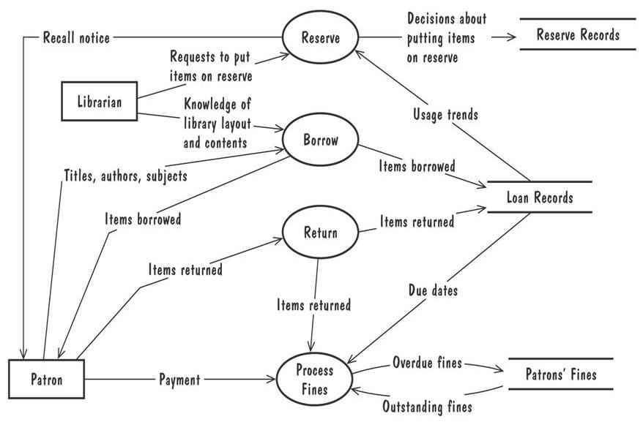
Data Flow Diagrams (Contd.)
A Level 1 data-flow diagram for the library problem
Process Reserve Requests
1
Process Borrow Requests
2
Process Returns
3
4
A verb in requirements narrative is potentially a process, a noun is either data, or external entity, or data store

Slide 7
Data Flow Diagrams (Contd.)
Refining DFDs
Processes are broken on the basis of known information, analysis of requirements
A process is broken until it becomes a primitive process (for example a single input flow, a single output flow, easy to be implemented by one person etc.)
Lower level DFD inputs and outputs must match those of the upper level DFD
It is a good practice to decompose/break one process at a time

Slide 8
Data Flow Diagrams (Contd.)
Example: A Payroll System
System Inputs:
Employee Records: employee name, id, pay history etc.
Employee Timecards: attendance and weekly/monthly work hours etc.
System Outputs:
Pay cheques
Accounting Report: for finance department

Slide 9
Payroll System
HR System
Secretary
Employee Information
Pay Cheque
Payroll System
Attendance System
Finance Dept.
Timecard Information
Accounting Report

Slide 10
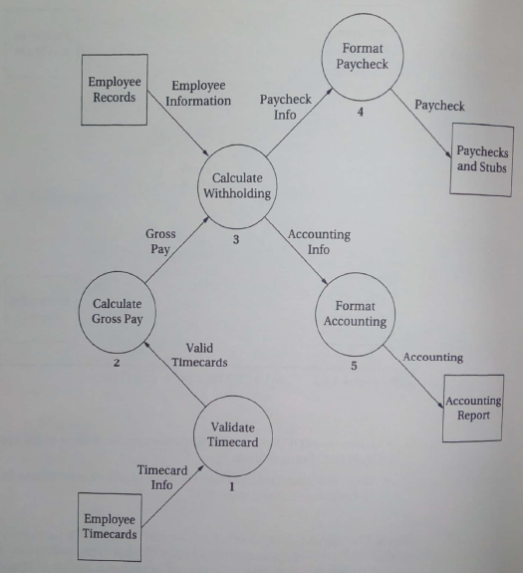
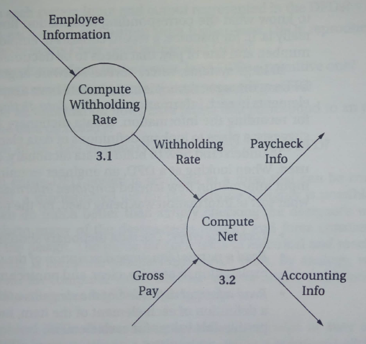
Payroll System
Witholding rate
Calculate Pay
Level 3
Pay Information
3.2.1
Paycheck Info
HR System
Gross Pay
Split Data
Primitive?
Secretary
Accounting info
3.2.2
Finance Dept.
Attendance System
Level 1
Level 2

Slide 11
Data Dictionary
A repository of data elements in each information flow
A place to lookup definition of data elements (alphabetically sorted)
Useful when multiple engineers are working on a DFD
Example:
Employee Information: contains payroll related information only. Excludes items such as address
Employee Name: 50-character alphanumeric field
Identification Number: 13 digit number (no hyphens). Holds CNIC number
Scale: 9-character alphanumeric field. Used to determine pay scale of the employee
Status: 7-character field. Stores if an employee is Current, Past, Active, or OnLeave
Filer or Non Filer: 2-character field. Stores is an employee is a tax filer or not. F means Filer, N means Non Filer

Slide 12
Data Flow Diagrams (Contd.)
Advantage:
Provides an intuitive model of a proposed system's high-level functionality and of the data dependencies among various processes
Disadvantage:
Can be aggravatingly ambiguous to a software developer who is less familiar with the problem being modelled

Slide 13
Exercise
Draw DFDs for the following and refine them to the extent you can:
Piccadilly Air Time Sales System
Consider an online telephone directory that is being developed to replace the phonebook that is provided by your phone company. The online directory should be able to provide you (the user) with phone numbers when presented with a name; it should also list area codes to the user for different parts of the country (given as input) and generate emergency telephone numbers for the given area code on request.

Slide 14
Checking Consistency of DFDs
The following checklist can be used to verify the consistency of a collection of DFDs:
Is each requirements function represented by a data transform somewhere in the DFDs?
Is each system input and output represented in the DFDs?
Is each input and output from higher-level DFDs reproduced correctly in any lower-level refinement DFDs?
Is each transform in the lowest-level DFDs a primitive one?

Slide 15
Checking Consistency of DFDs (Contd.)
The following checklist can be used to verify the consistency of a collection of DFDs (contd.):
Do all transforms have unique heritage designators?
Do all information flows have labels that correspond to an entry in the data dictionary?
Do all data dictionary entries appear in some DFD?

Slide 16
Exercise
Video-Rental Ltd. (VRL) is a small video rental store. The store lends videos to customers for a fee, and purchases videos from a local supplier. They need a computerized system that helps them run their daily business. Description of their daily business is as follows:
Only a registered customer can borrow videos from the store. New customers register by filling out a form with their personal details and credit card details. The credit card details are used to pay subscription fee, video borrowing fees, and overdue fines. On successful payment of subscription fee, the customer is issued a membership card by VRL. The membership card has a unique membership id which is later used when borrowing videos. Each new customer's form is also added to the customer file. A customer can request a video by providing video title, his/her membership id, and payment – payment is always with the credit card used to open the customer account. If the payment is successful the customer is handed over the video by VRL. The customer then returns the video to the store after watching it. If a loaned video is overdue by a day the customer's credit card is charged, and a reminder letter is sent to the customer. Each day after that a further transaction on card is made, and each week a reminder letter is sent. This continues until either the customer returns the video, or the charges are equal to the cost of replacing the video. The local video supplier sends a list of available titles to VRL, who decides whether to send the supplier an order and payment. If an order is sent then the supplier sends the requested videos to the store. For each new video a new stock form is completed and placed in the stock file.

